Slide 1
The Landscape of Higher Education

Slide 2
Slowing growth in number of U.S. high school graduates, then decline (U.S. total high school graduates)
Source: Western Interstate Commission for Higher Education, Knocking at the College Door, 10th edition, 2020.

Slide 3
The net result…we are and will experience very slow compounded growth rates by historical standards
1963-1980
2000-2010
2010-2018
2019-2029
5.6%
3.2%
-0.8%
0.24%
Note: Between 1981 and 1999 the compounded growth rate was 1%
Source:: NCES

Slide 4
Graduate enrollment is expected to increase slightly over the next several years
Source: US Department of Education, Institute of Education Sciences, National Center for Education Statistics, 2018 Digest of Educational Statistics: Table 303.80

Slide 5
More than 1 in 4 entering students questions whether college is worth it
26%
2021
Mid-pandemic
25%
2019
Post-recession
17%
2009
Mid-recession
2021 National First-Year Students and Their Motivations to Complete College Report

Slide 6
Average tuition and fee charges in constant dollars
1987-88 to 2017-18 (enrollment weighted)
Source: Data derived from 2020 Trends in College Pricing. Copyright © 2020, the College Board. www.collegeboard.org. Reproduced with permission. This data may not be posted, published, or distributed without permission from the College Board.

Slide 7
Signs students with greater need may feel they cannot afford higher education and are not applying.
© 2021 Discounting Report for Four-Year Private and Public Institutions
Ruffalo Noel Levitz, LLC

Slide 8
Illinois
The competition factor
 | In-state Counts | Percentage | Rank
2021-22 High School Seniors* | 148,830 |  | 5th
Institutions of Higher Education** | 162 |  | 7th
College Continuation*** | 112,962 | 75.9% | 20th
Leave the State to Go to College*** | 36,616 | 24.6% | 11th
Largest Institutions*** | In-state Freshman*** | Estimated Market Share^
University of Illinois at Urbana-Champaign | 5,811 | 5.14%
University of Illinois at Chicago | 3,686 | 3.26%
Illinois State University | 3,573 | 3.16%
College of DuPage | 3,196 | 2.83%
William Rainey Harper College | 2,299 | 2.04%
Remaining Students | Remaining Institutions | Students Per Institution
57,781 | 157 | 368
Sources:
*Western Interstate Commission for Higher Education, Knocking at the College Door: Projections of High School Graduates, 2020, www.knocking.wiche.edu
**National Center for Education Statistics, IPEDS, 2020
***National Center for Education Statistics. Freshman Migration Data for 2018-19

Slide 9
Understanding the needs of today’s students
79 times is the average number of times a student unlocks their phone each day
70% of students bypass direct marketing and search on their own
81% rate their family, friends and online reviews as their top influence when deciding what to purchase
Financially savvy – Debt adverse
Over 80% of global internet users are engaged in online communities
Top channels
Website
Email
Social Media
Text
Top desired content
Academic programs
Cost/Aid/ Scholarships
What the community is like
Videos
2021 RNL University Family Engagement Survey
2021 RNL High School E-Expectations Report
https://amplifysolutions.ca/gen-z/
https://www.statista.com/statistics/1050339/average-unlocks-per-day-us-smartphone-users/

Slide 10
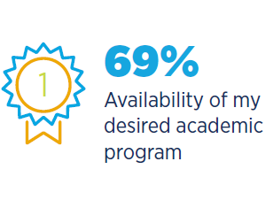
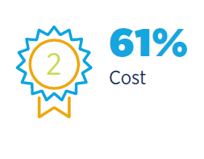
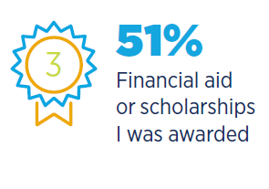
Most important factors in the students’ decision to attend a particular institution
2020 RNL High School Perceptions of College Financing Report

Slide 11
How satisfied are college students?
Percentages indicates the proportion of “satisfied” or “very satisfied” scores
© Copyright 2021 Ruffalo Noel Levitz, LLC
2021 National Student Satisfaction and Priorities Report

Slide 12
How likely are students to re-enroll?
Percentages indicates the proportion of “probably yes” and “definitely yes” scores
© Copyright 2021 Ruffalo Noel Levitz, LLC
2021 National Student Satisfaction and Priorities Report

Slide 13
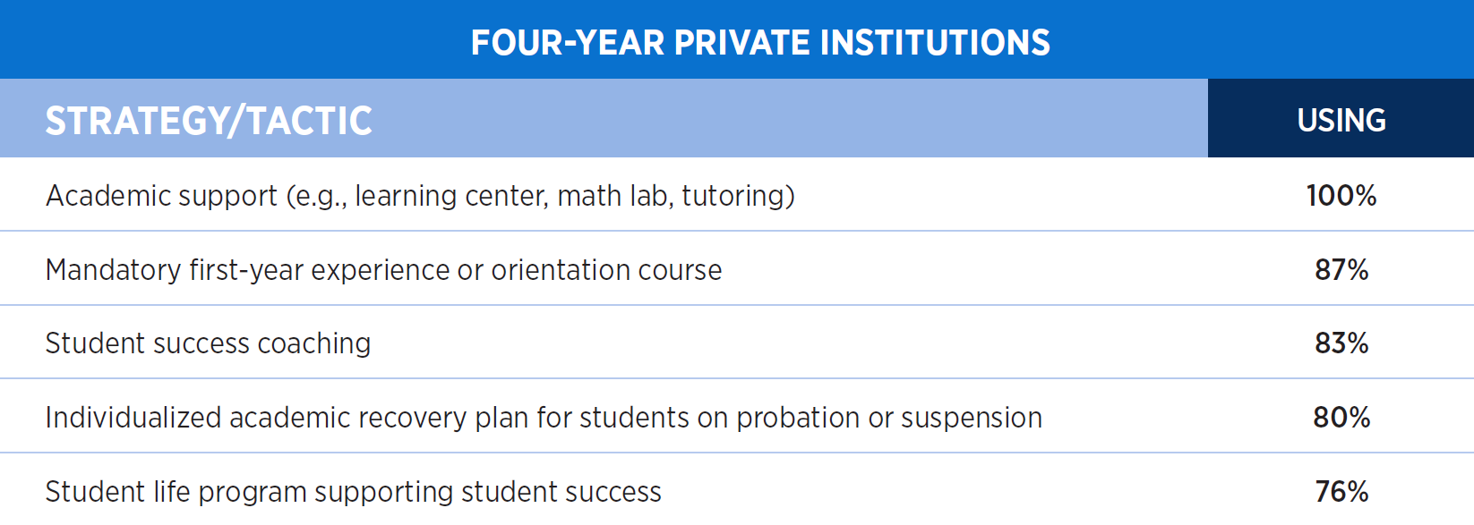
Most widely used strategies and tactics for student success, retention, and completion

Slide 14
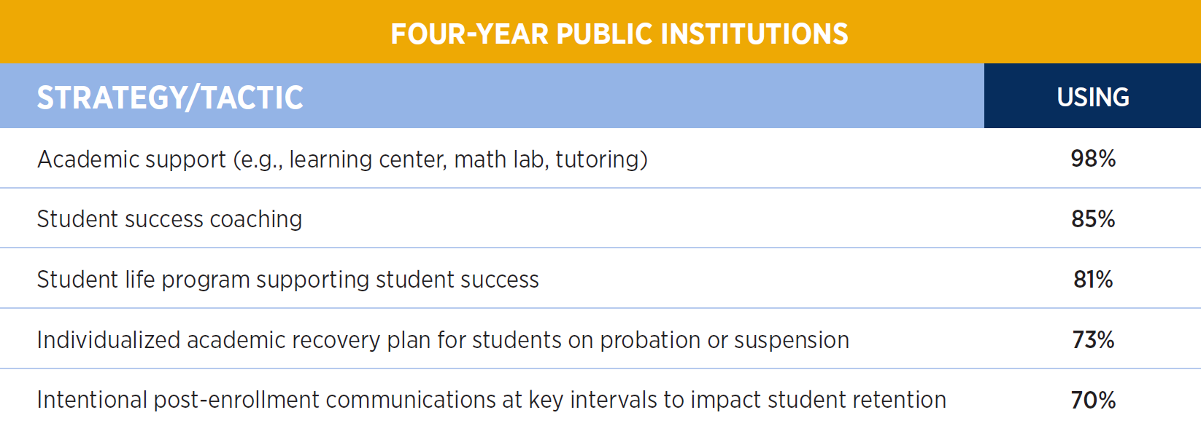
Most widely used strategies and tactics for student success, retention, and completion

Slide 15
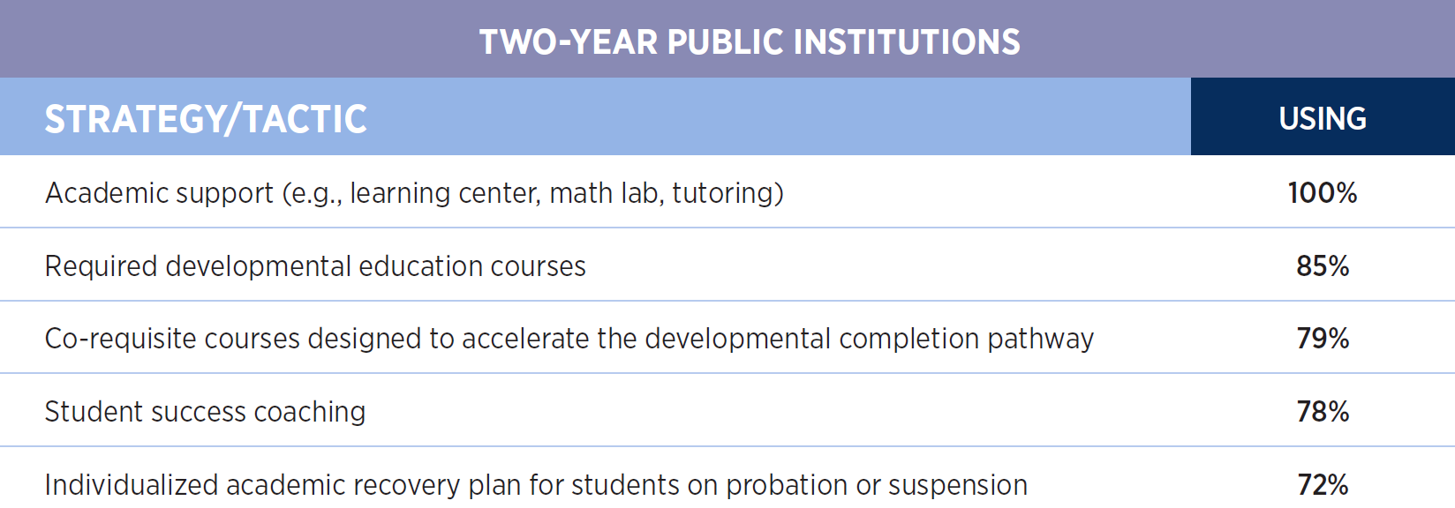
Most widely used strategies and tactics for student success, retention, and completion

Slide 16
Percentage of institutions using a predictive model to predict the likelihood of an incoming student persisting to degree completion

Slide 17
What guides retention planning efforts?
Percentage of institutions where a written plan guides efforts aimed at student success, retention, and completion

Slide 18
Opportunities and Strategies for YOUR Institutions
Create and execute recruitment and retention plans based off a strategic enrollment plan
Identify key retention variables early and often into a student’s enrollment to your institution
What does student success mean to your institution? A campus community mission
Explore student success coaching models to compliment academic advising
Ensure a One-Stop-Shop mentality (both physical location and/or in practices) has been established on campus with financial aid, student accounts, student success offices, and the registrar

Slide 19
The Relationship of SEP to ISP
Institutional Strategic Planning

Slide 20
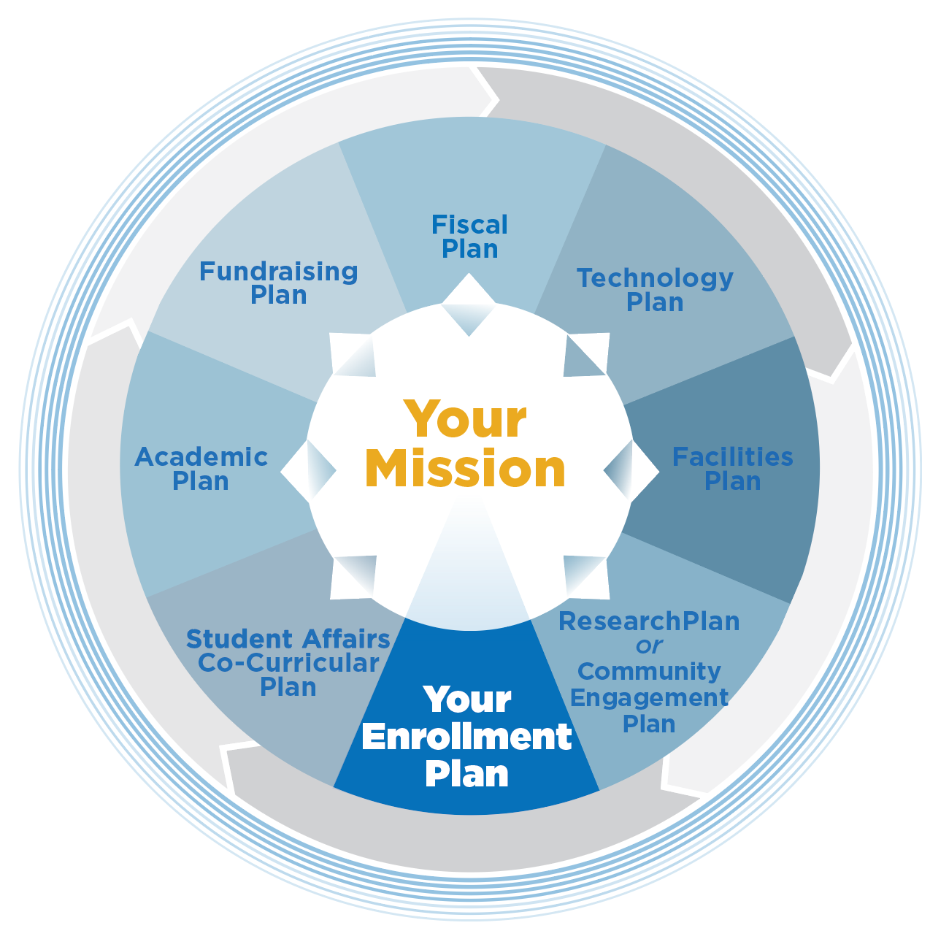
Strategic Enrollment Planning Scope: The institutional perspective
Notes:
‘large’ version’

Slide 21
Strategic Enrollment Planning Involves:
Program (academic, co-curricular, services, support)
Place (on-site, off-site, online, hybrid)
Price and Revenue (tuition, fees, discounts, incentives)
Promotion (marketing, recruitment, web presence)
Purpose and Identity (mission, distinctiveness, brand)
Process (data-informed, integrated planning)
SEP
Program
Place
Price
Promotion
Purpose
Process

Slide 22
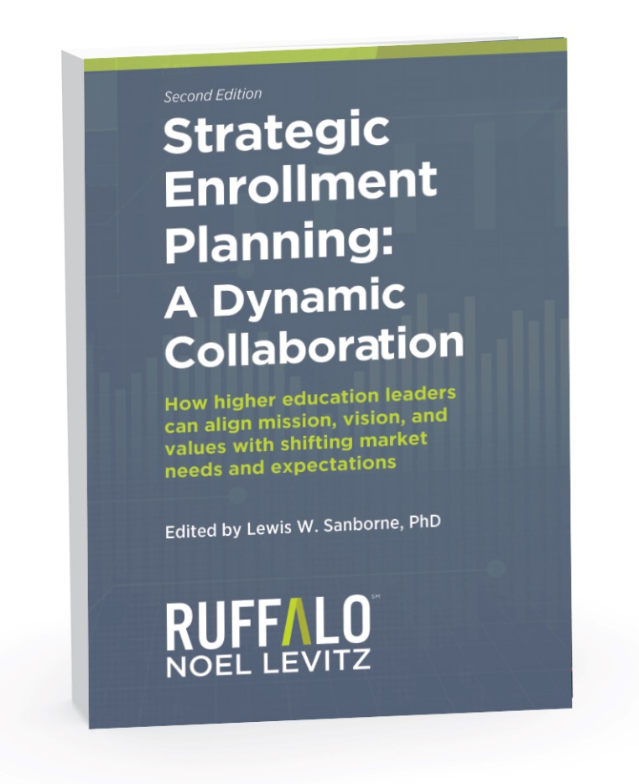
3rd edition, preview today, ready spring 2022

Slide 23
Student Success Solutions
A 360 Degree Approach

Slide 24
RNL Results and Experience with Student Retention Strategies

Slide 25
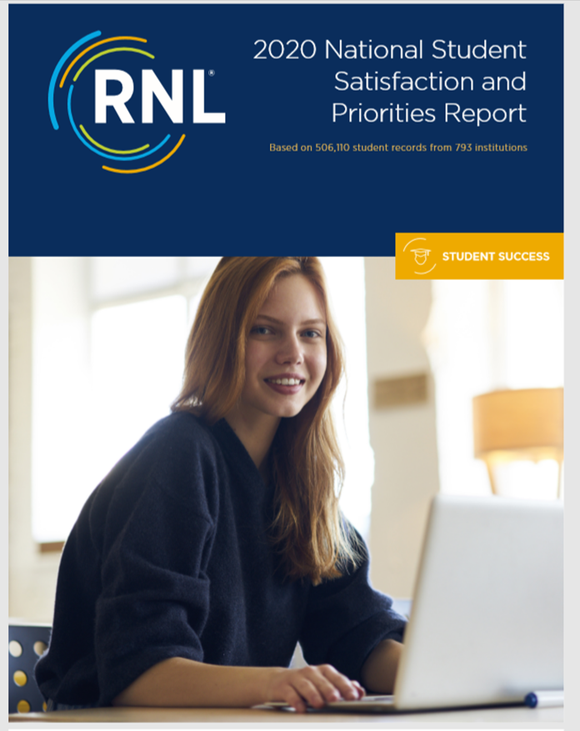
RNL Research and Reports
Insights to plan on
2021 RNL E-Expectations Trend Report
2020 Marketing and Recruitment Practices for Undergraduate Students
2020 Cost of Recruiting an Undergraduate Student Report
2020 High School Student Perceptions of College Financing Report
E-Expectations of Transfer Students: A 2020 Trend Report
2021 Discounting Report for Four-Year Institutions
2020 Student Success and Retention Benchmarks
2021 Effective Practices for Student Success, Retention, and Completion Report
2021 National First-Year Students and Their Motivation to Complete College Report
2021 Graduate Student Recruitment Report
2021 University Family Survey
2019 Parents’ Role in College Planning Report
National Adult Student Satisfaction and Priorities Report
2020 National Student Satisfaction and Priorities Report

Slide 26
Questions and Discussion

